Slide 1
Intro to Boolean Logic
CS 142
David Anderson
Slides by Martin Hock

Slide 2
Overview
Today, we’ll start with material from Ch 4 including boolean values and conditional expressions
Tomorrow, we’ll see how to use boolean values to control execution None of this material is needed for the assignment!

Slide 3
boolean type and values
So far, we’ve learned about integer types (int), floating point types (double), and the String type
There’s another really simple type we should learn about: boolean
boolean has only two possible values: true and false
These are boolean literals as well as reserved words

Slide 4
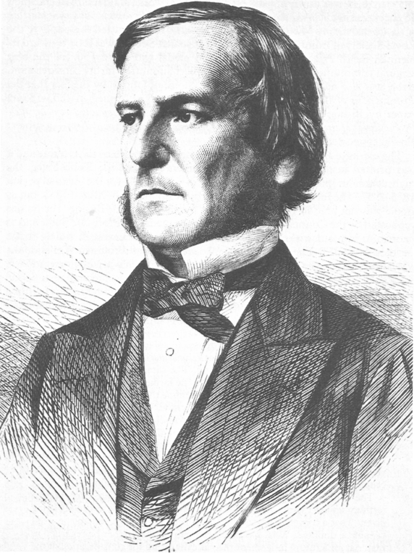
Boolean logic
George Boole was a mathematician in the 19th century
Took the concepts he had in English of “true”, “false”, “and”, and “or” and came up with formalized mathematical rules for them
The rules are rigid and in some ways reminiscent of 19th century English

Slide 5
Relational (comparison) operators
We can compare numbers to each other and get a boolean back out
Greater than > , less than < , greater or equal >=, less or equal <= , equal to ==, not equal !=
PAY CLOSE ATTENTION to the two equals signs above for “equal to”!
Single equals sign is assignment!
= is “equality by force”: you cause the variable to become the new value
== is “check for equality”: evaluates to true if operands are equal in value
Comparison is performed within an expression in Java, such as within assignment to a variable or returned by a method
The comparison is determined at evaluation time and the result is either true (comparison holds now) or false (comparison does not hold now)

Slide 6
Math vs Java
Consider the mathematical expression x > 5
The expression is satisfied for all values x which are greater than 5: 100, 5.1, 5.00000001, etc.
In some contexts, you could think of x as consisting of all possible such values
Contrast with Java, where we evaluate the expression x > 5 and determine a boolean value according to x’s value at the time of the evaluation
We can assign the result of that evaluation to a variable, return it from a method, or use it within another expression

Slide 7
Example of Java boolean evaluation
int x = 1;
int y = 2;
boolean xGTy = x > y; // determine whether x > y
x = 3; // now x is greater than y!
System.out.println(xGTy);
What will the above code print?

Slide 8
Boolean example #1
Create a class LogicIntro with a main method
Write a method isDozen which has an integer argument and which returns true when the argument is exactly equal to a dozen (twelve)
public static boolean isDozen(int amount) {
Write a return statement here!
It will look like: return [something] [comparison operator] [something else];
Replace [something] and [something else] with a numerical expression (literal or variable)
Replace [comparison operator] with one of the operators on the previous page
}

Slide 9
Boolean example #1 answer
Write a method isDozen which has an integer argument and which returns true if the argument is exactly equal to a dozen (twelve)
public static boolean isDozen(int amount) {
return amount == 12;
}
Notice we needed two equals signs to compare the amount variable
Otherwise, Java would try to change the value stored in the amount variable
The result would not be a boolean value so the Java compiler complains

Slide 10
Test the method
We can test the isDozen method from the main method:
public static void main(String[] args) {
System.out.println(isDozen(10));
System.out.println(isDozen(12));
System.out.println(isDozen(13));
}
It will print the following to the console:
What if we wanted to allow both a regular dozen and a baker’s dozen (thirteen)?
false
true
false

Slide 11
Boolean operators and expressions
And && , or || (two vertical bars, also known as “pipes”), not !
Single & and single | is a weird “bitwise” operator you will rarely need to use
Origins in C and its predecessors
expr1 && expr2 is true when both expr1 and expr2 evaluate to true
x || y is true when at least one of x or y is true (OK if both are true)
There is also a rarely used ^ operator for exactly one of x and y is true (exclusive or)
!x is true if x is false and false if x is true (negates the value of x)
&& is higher precedence than || but lower precedence than most other operators
It’s worth using parentheses in boolean expressions even if not strictly necessary to help clarify things
As with math operators, we combine values together to create expressions

Slide 12
Boolean example #1a answer
Modify isDozen to allow both 12 and 13 for amount
public static boolean isDozen(int amount) {
return amount == 12 || amount == 13;
}
Notice that even though we said “and” in the prompt, we used “or”
A variable can’t be both values; if we want to allow both scenario a and scenario b, we have to allow either scenario a or scenario b
Notice that even though we just said “12 and 13”, we had to spell out the comparison with amount both times
English has a “distributive property” of subject and verb that Java doesn’t have
Java requires a boolean expression on both sides of the && and || operators

Slide 13
Boolean example #2
Let’s say you have a dog. Your dog is happy whenever it has been fed and has either been walked or played with (or both)
Let’s say you already have boolean variables fed, walked, and playedWith and you want to calculate the “happiness” of the situation (true or false)
Write the body of a method public static boolean dogIsHappy(boolean fed, boolean walked, boolean playedWith) { // Write a return statement here! } which returns true if the dog is happy and false if it is not

Slide 14
Boolean example #2 answer
return fed && (walked || playedWith);
This also works: return (fed && walked) || (fed && playedWith);
We are repeating ourselves more than we need to, though
This doesn’t work: return fed && walked || playedWith;
Because && is higher precedence than ||, in English, it’s saying: “The dog is happy if it is fed and walked, or if it’s played with”

Slide 15
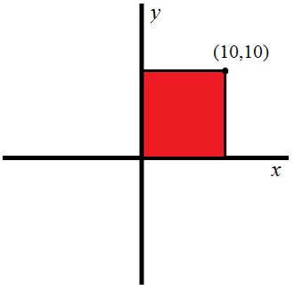
Boolean example #3
Suppose you have int variables x and y and you want a boolean expression which is true if the point corresponding to (x, y) is located in or on the border of the square
public static boolean isInSquare(int x, int y)

Slide 16
Boolean example #3 answer
x >= 0 && x <= 10 && y >= 0 && y <= 10
We haven’t seen a good way to avoid repeating ourselves yet
Note that you CAN’T write 0 <= x <= 10 like you can in math
Note that you CAN’T write x >= 0 && <= 10 like we might say in English
As with any expression, we can assign the result to a variable
boolean inRange = x >= 0 && x <= 10 && y >= 0 && y <= 10;
Next, we’ll learn how to write programs that use boolean expressions to make decisions!

